Slide 1
Developed in Luxembourg
pretty Easy privacy

Slide 2
The World is threatened…
…our privacy and security is gone!
Google, Facebook, WhatsApp,… are all reading, selling and using our data for their benefit and provide no security.
Snowden has proven that governments record all internet traffic, have built back-doors and access into software, hardware and cloud solutions.

Slide 3
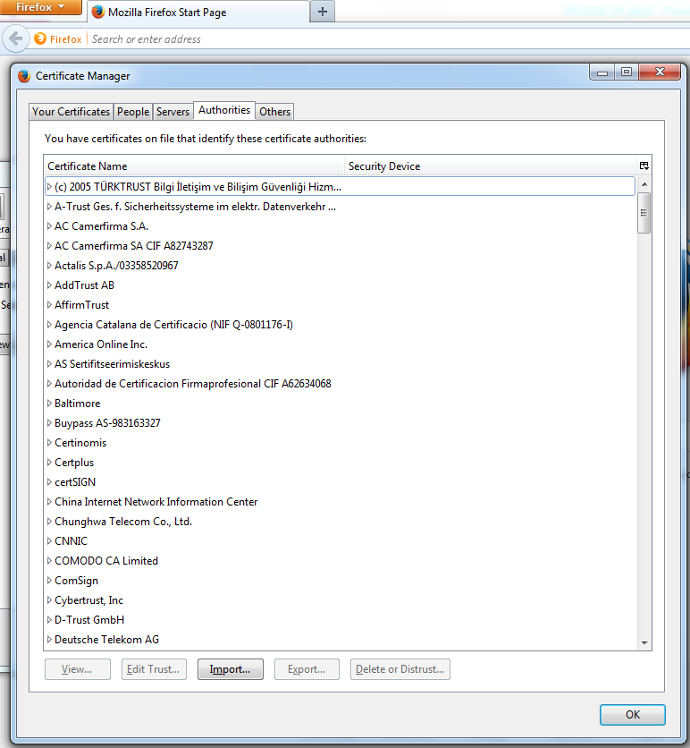
Protection is compromised
The common protection technology TLS (based on X.509) is compromised if:
one single Certification Authority (CA) is taken (hacked, undermined, infiltrated) …
… like the NSA in the most probable case…
… then all communication – using software which is trusting this CA – is compromised.

Slide 4
Protection is compromised
We have to reconquer our hardware.
We have to reconquer our software.
We will not get the network back.

Slide 5
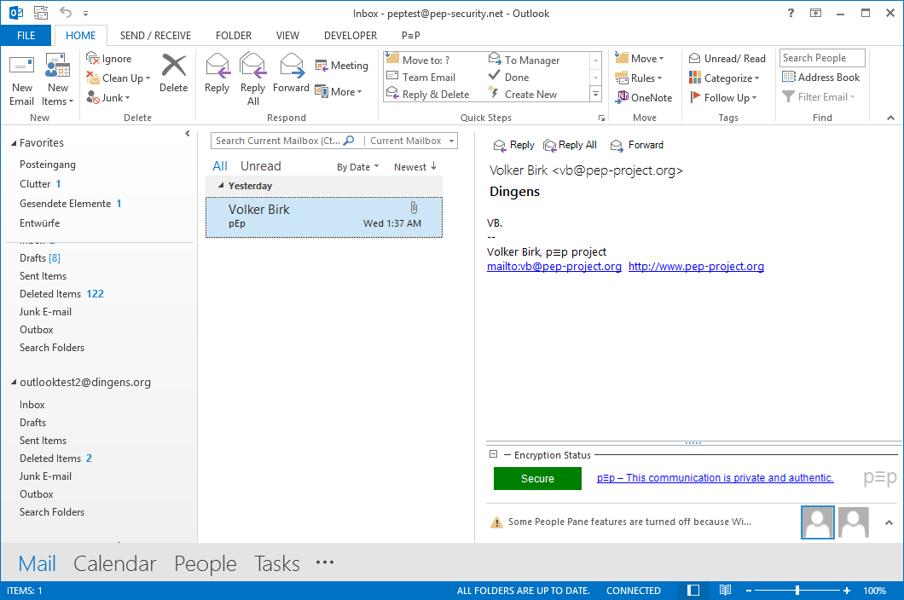
p≡p. Outlook Illustration.
Notes:
After the installation, there are no keys in pEp.

Slide 6
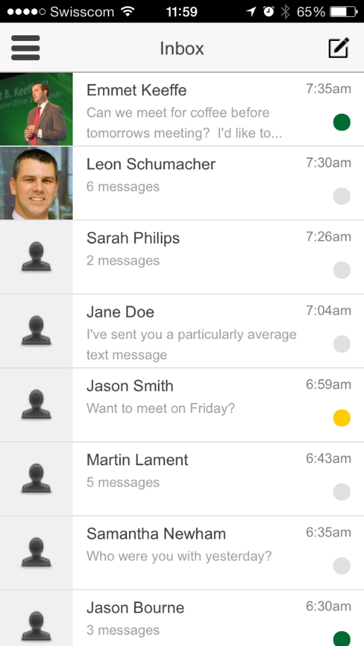
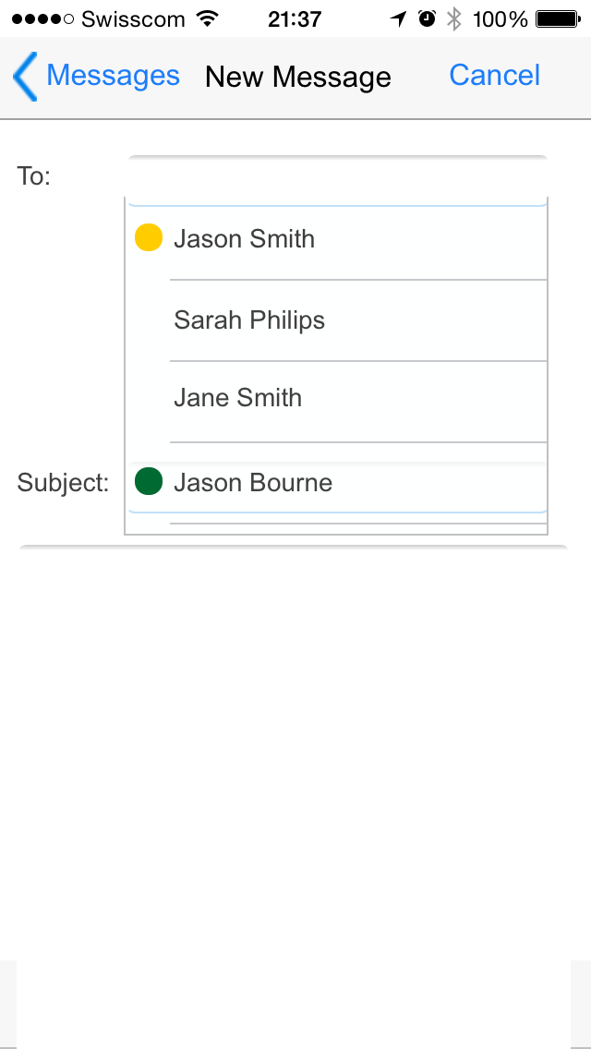
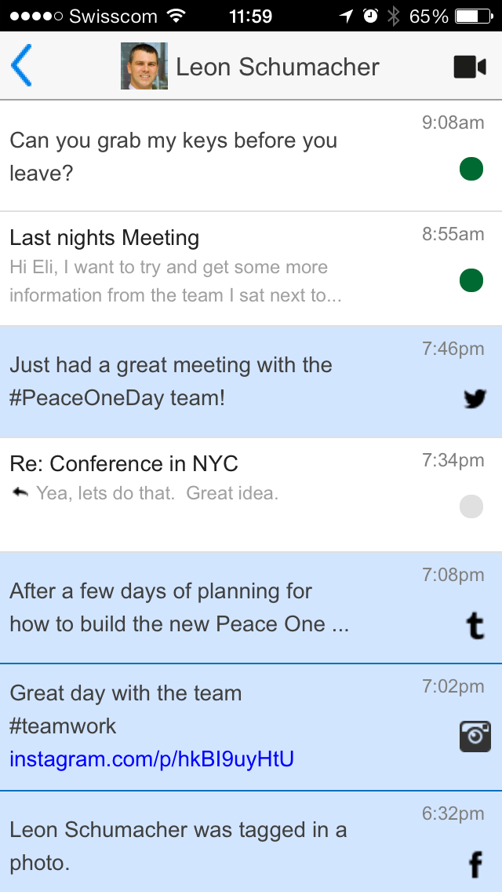
p≡p. iPhone Illustration.
Notes:
Here is now an illustration of the iPhone app with the convergence of all communication channels. It shows the inbox of a user with all new messages (email, messages, twitter, facebook, instagram,…). When I want to sent a message, it looks like a normal mail app.
Now I want to make Jason Smith green (do the handshake), here are the only steps pEp will ask a user to do.

Slide 7
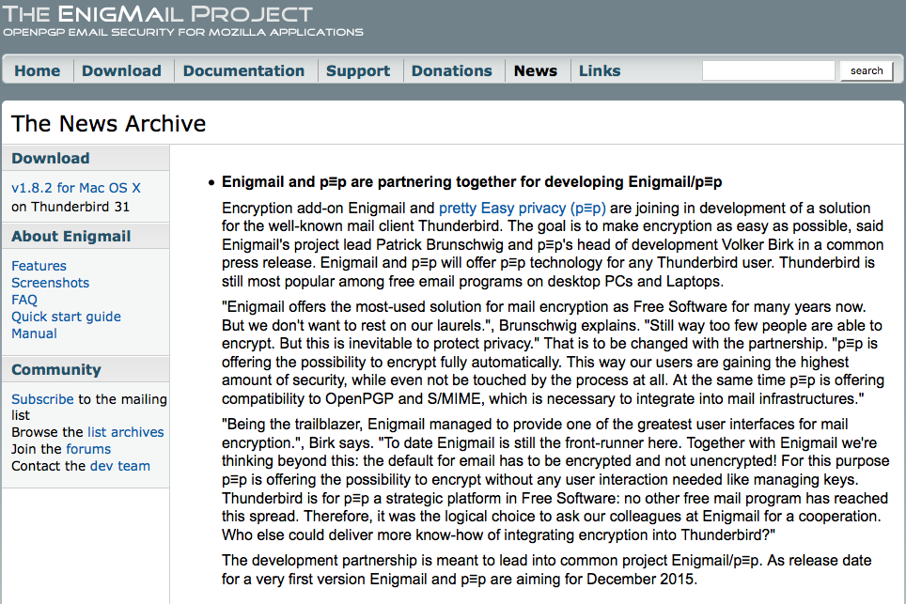
Enigmail/p≡p.

Slide 8
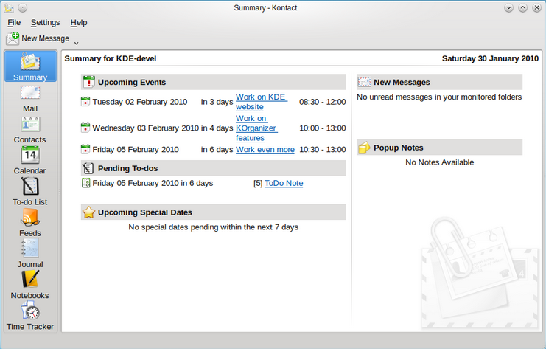
p≡p in Kontact.

Slide 9
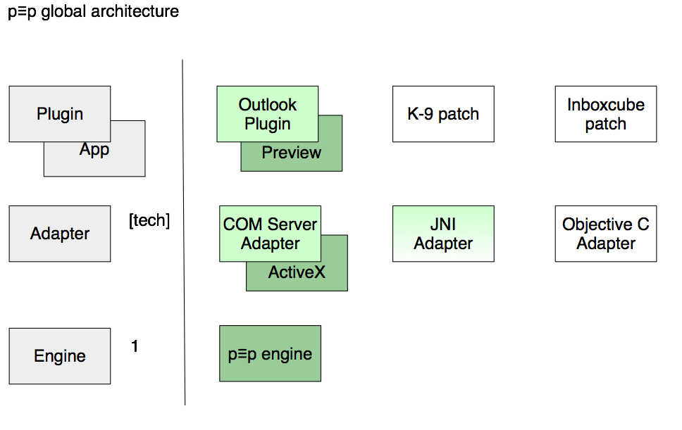
p≡p. Behind the curtain.

Slide 10
p≡p Engine.
Key Management System
Creates and Revokes own Key Pairs
Manages Public Keys of Communication Partners
Default: Key servers read-only, PKs as attachments
Default will change to not using key servers any more
Trust Rating System
1st: Rating is based on encryption
2nd: If (and only if) highest rating for encryption, Rating is based on trust information
Notes:
Pep outlook in C#.net
Pep engine in C99 - dual license (GPL and commercial)

Slide 11
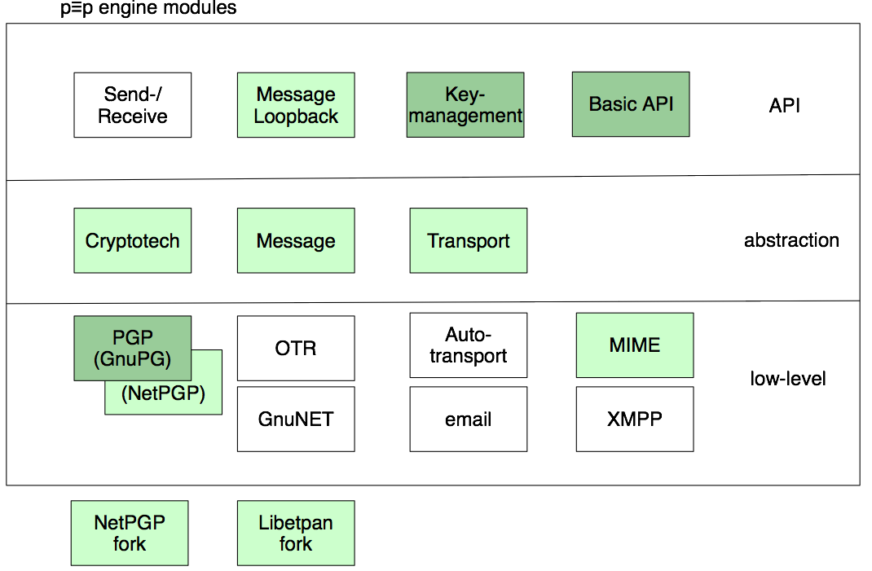
p≡p. iPhone Illustration.

Slide 12
The Messaging Landscape
Datamotion
Voltage
Echoworx
Symantec
Peanut
SMS
Zixcorp
Totemo
TrendMicro
LuxSci
Privato
Enigmail
Email
Agari
Mailpile
Textsecure
p≡p
Darkmail
Virtru
Neocertified
Edgeware
Cryptzone
Encryptomatic
BBM
Mysecureemail
Walnut
Heml.is
myEnigma
Threema
iPGmail
K9mail
Kaitenmail
Messaging
Sophos
IronPort
Barracuda
Wickr
Telegram
Proofpoint
Seecrypt
Surespot
Silentcircle
Tigertext
Chatsecure
HoccerXO
Kontalk
iMessage

Slide 13
p≡p Engine.
Transport System
E-Mail
Jabber, …
Facebook API, …
GnuNet
Encryption System
OTR
OpenPGP: GnuPG, Fallback: NetPGP
Notes:
Pep outlook in C#.net
Pep engine in C99 - dual license (GPL and commercial)

Slide 14
Simple. Sane. Secure. p≡p.
End to End Cryptography only.
Reliable and widely tested algorithms only.
Only Open Source Software as the Core Engine.
And only you have the keys.

Slide 15
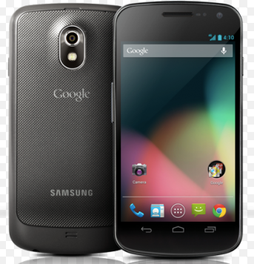
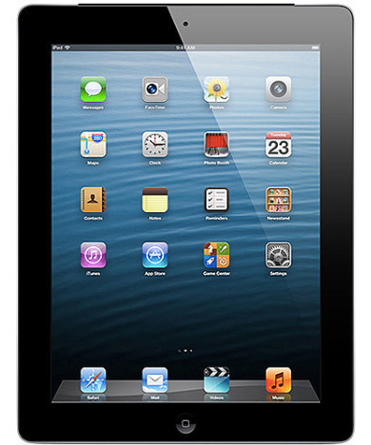
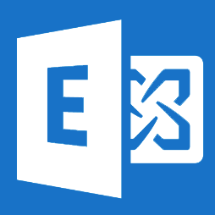
p≡p. The family.
Android (K-9 with p≡p)
iPhone
with p≡p
p≡p for Outlook
p≡p for Apple Mail
iPad
Browser Plugin
with p≡p
p≡p Enterprise Edition
Connector Box

Slide 16
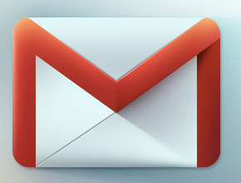
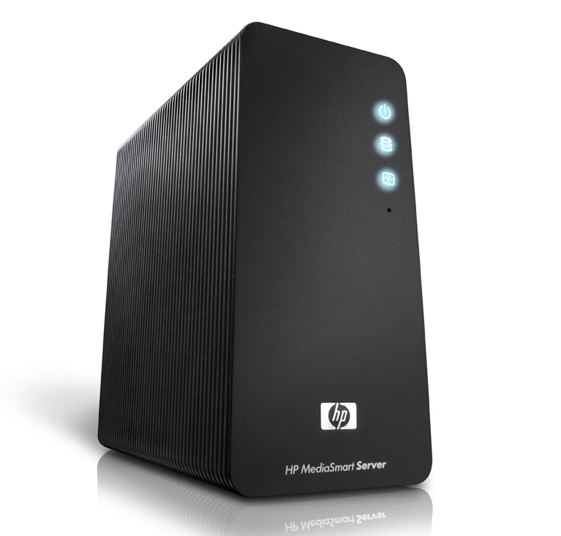
p≡p – Product Family Collaboration
Cloud e-mail
Web mail
On premise e-mail
p≡p
Products
p≡p
Products
encrypted
not encrypted
pEp Outlook

Slide 17
p≡p. Key Elements.
p≡p is seamless and fully automated integration of security in Mobile, Web and PC communication.
p≡p provides zero-touch experience with privacy on ALL your communication channels (E-Mail, Messaging, SMS…).
p≡p works with other standards and automagically at a higher security after simple handshake with ‘trustwords’.
p≡p

Slide 18
Developed in Luxembourg
pretty Easy privacy

